Slide 1
Toll Subsidy
30 Days Before
30 Days After

Slide 2
Before Subsidy (Shuffled)
Driver 4 Value
Driver 9 Value
Driver 8 Value
Driver 10 Value
Driver 3 Value
Driver 12 Value
Driver 5 Value
Driver 11 Value
Driver 6 Value
Driver 2 Value
Driver 7 Value
Driver 1 Value
After Subsidy (Shuffled)
Driver 12 Value
Driver 11 Value
Driver 5 Value
Driver 3 Value
Driver 7 Value
Driver 4 Value
Driver 8 Value
Driver 1 Value
Driver 2 Value
Driver 10 Value
Driver 9 Value
Driver 6 Value
Mean
Permuted Mean of Differences ₁

Slide 3
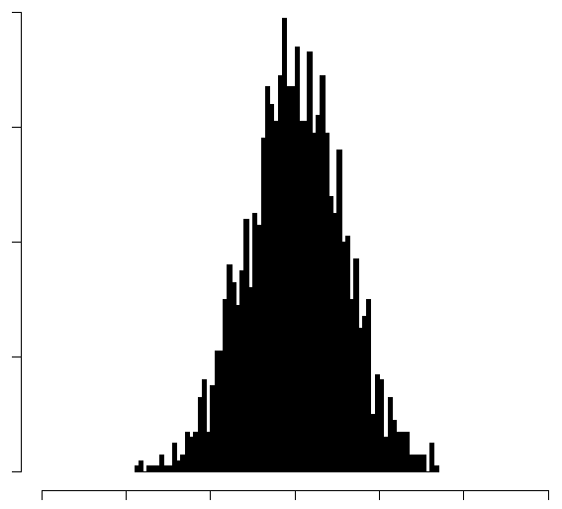
Histogram of N Permuted Mean Differences
Plot the region where our Actual Mean Differences lie. Compute the area of region above it to acquire “P-Value”. If P-Value < Some Threshold (Typicall .05), our differences are unlikely due to chance variation where the Mean Difference of Out-Of-City Rates are independent of a toll subsidy.

Slide 4
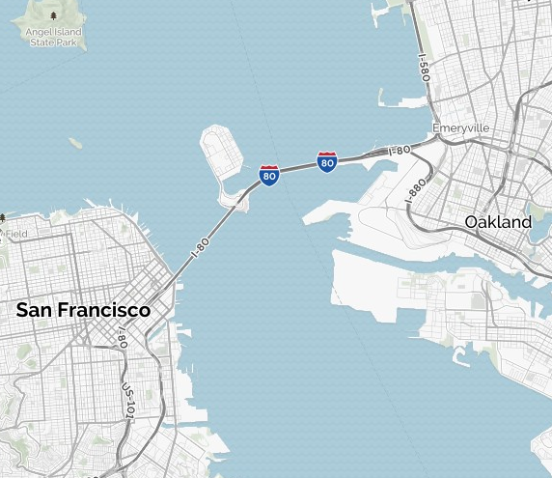
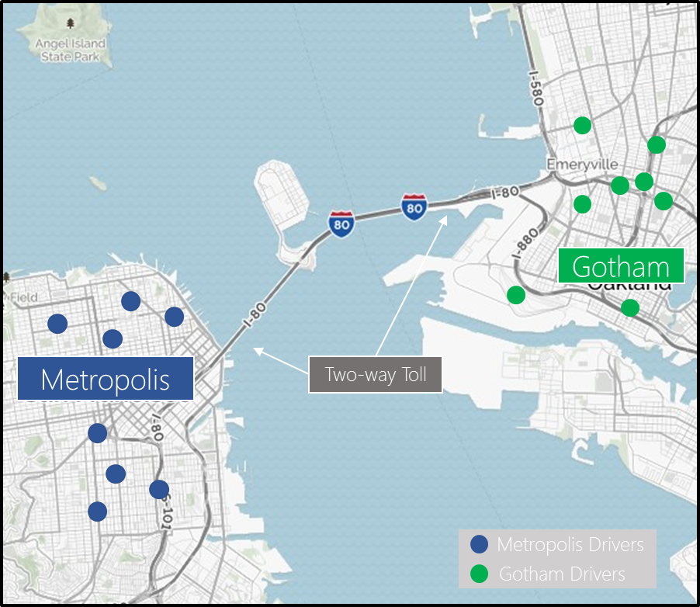
Gotham
Metropolis
Two-way Toll
Metropolis Drivers
Gotham Drivers

